Slide 1
Keep Your Time
Final Presentation

Slide 2






Document repository

Slide 3
Document Repository
Google Code
Keep Your Time Project
Documentation
Meetings
Processes
Project Management
Templates
Test Results
Weekly Reports

Slide 4
Document Repository
Google Docs
Documents, Requirements, Tests and Review Measures
Dashboard
Logs

Slide 5
Document Repository
Google Sites
Project Information
Dashboard
Repository
Logs (link)
Project Documentation
Templates
Processes
Weekly Report
Meeting minutes
Kickoff Meeting
Code Repository (link)

Slide 6
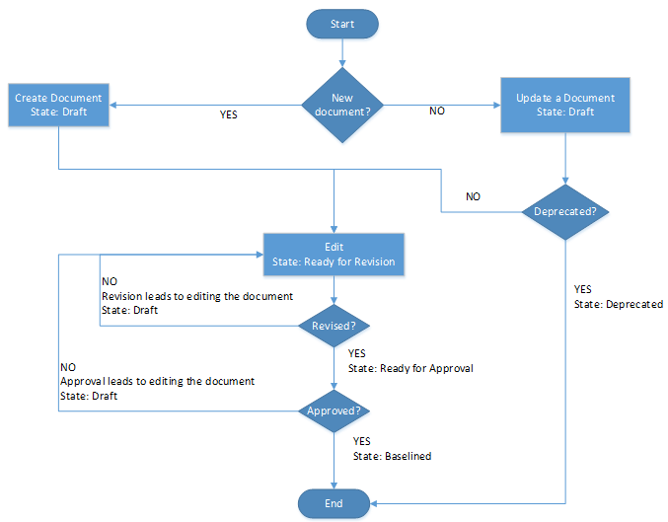
Document Repository
Documents state
Draft: 2
Ready for Revision: 0
Ready for Approval: 0
Baselined: 29
Deprecated: 0
Global Change Rate: 0,066

Slide 7
Individual Analysis
Helped when it was needed
Did the tasks given
Interested in the project
Contributions
Update the repository
Writing some processes
SRS and Requirements Definition
Review and approval of some documents
Coding some features

Slide 8
Individual Analysis
Lessons Learned
Teamwork is the key to sucess
The structure of the application should be well planned

Slide 9
Questions?

